Slide 1
Module 4: Managing AWS Expenses

Slide 2
Activity 4-1
Total Cost of Ownership (TCO) = all costs associated with running an application.
For AFL lets start the TCO exercise – thinking of one of their applications that operates on-premise, what are the data points that you would collect?
As a group, discover & discuss all the data categories you can think of that reflect true TCO, derive a consolidated list. One category per sticky note.

Slide 3
Module 4: Managing AWS Expenses
Total Cost of Ownership (TCO)

Slide 4

Did you think of all items that relate to TCO?
Data center space
Data center power
Data center cooling
Racks
Structured cabling
Physical Security
Parking
Data center monitoring
Operating system licenses
Application licenses
Database licenses
Storage
Network bandwidth
Maintenance contracts
Tech people
Non tech people

Slide 5
When should I tackle on-premise vs. cloud TCO?
When choosing a cloud provider, it is one factor
When starting your cloud journey, we recommend you do TCO upfront
Gets enterprise wide buy-in
Stops post-migration second guessing

Slide 6
Module 4: Managing AWS Expenses
Expenditure Management and Cost Optimization

Slide 7
How do we optimize
AWS costs?
How do we manage AWS expenditure?

Slide 8
In principle…
Match supply with demand
Do not over-provision
Use cost-effective resources
Right mix and size of resources
Expenditure awareness
Identify and attribute costs to individual business owners
Optimize over time
Continuously re-evaluate design and explore new AWS products

Slide 9



What about scale?
Users…
Instances…

Slide 10
What we found: effective cost optimization is…

Slide 11







Driven by…
These consistent, heavy-hitting
cost optimization levers
+
Continuous improvement – measure, monitor, improve
People
Rightsizing
Cloud team / Cloud COE
Organizational buy-in
Partners to accelerate
Process
Elasticity
Targets and Metrics
Report on savings
Cloud operating model
Technology
Reserved Capacity
Automate, automate, automate
Auto-tagging, auto-scaling, tooling for reporting and metrics

Slide 12
Application Migration
Leverage the cloud – elasticity, do not overprovision
Purchasing Options (Spot, RI)
Continuous improvement
Baseline: what I need vs what I current have
Leverage AWS managed services, different configuration options
POC: Validate environment
Verify costs at multiple usage levels
Verify costs of different system configurations
TCO
ASSESS
PILOT
MIGRATE
STEADY STATE

Slide 13
Effective cost optimization
A real customer example

Slide 14
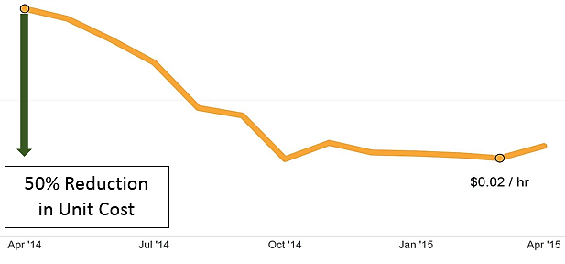
The Journey
$0.13/hour
$0.06/hour

Slide 15
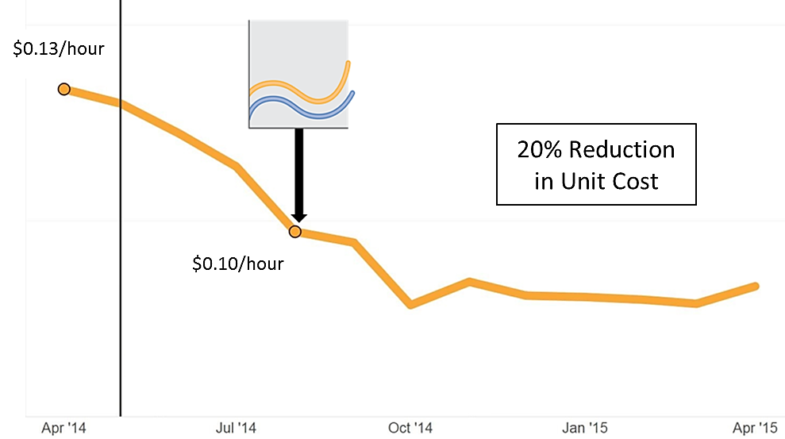
Begin to turn off non-production daily

Slide 16
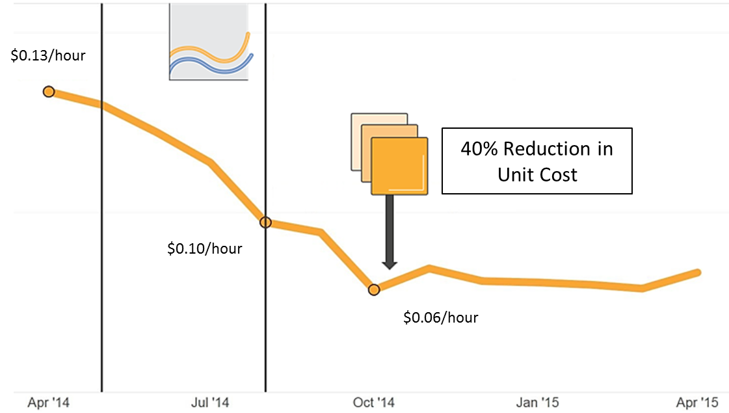
Begin purchasing Reserved Instances

Slide 17
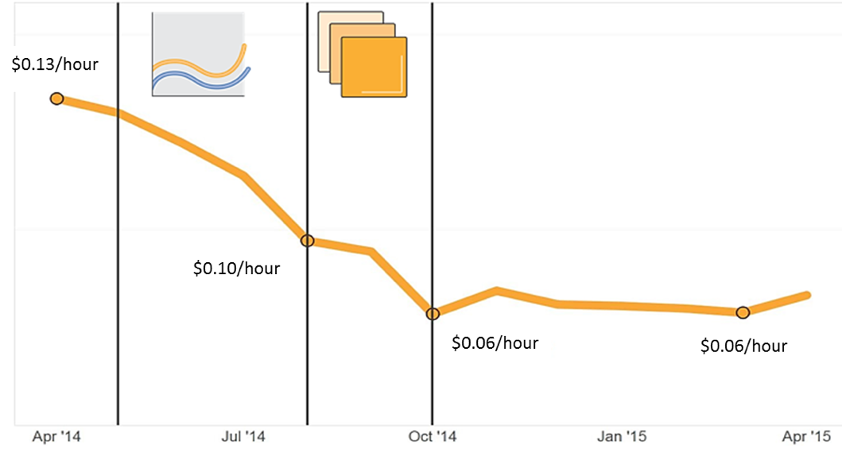
Optimizing from $0.13/hour to $0.06/hour
What | Apr ‘14 | Apr ‘15 | Δ
Peak Compute Usage | 471k vCPU | 4105k vCPU | 8.7x
Instance Costs | $59k pm | $244k pm | 4.1x
$185k
saving per month!

Slide 18
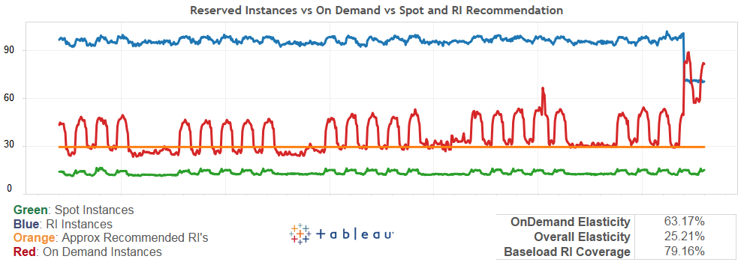
Elasticity

Slide 19
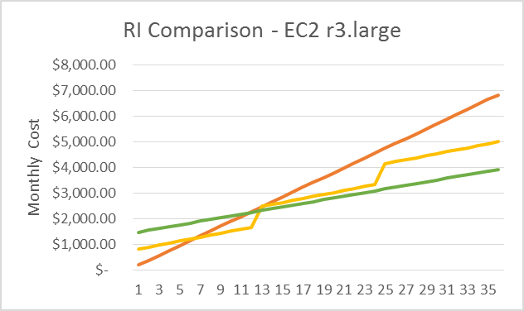
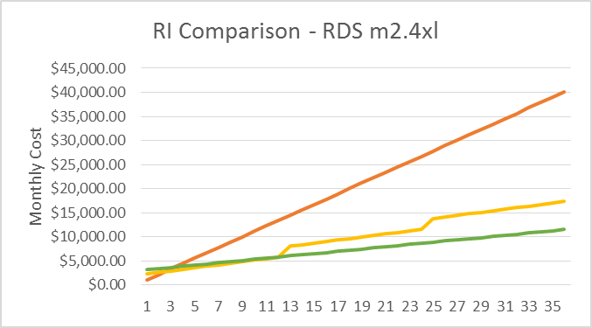

Reserved instances / capacity
Usage commitment + optional upfront payment
Reserved Instance | 36 Month Cost | Saving
On Demand | $ 6,832.80 | 0%
1yr Partial | $ 4,999.68 | 27%
3yr Partial | $ 3,930.88 | 42%
Reserved Instance | 36 Month Cost | Saving
On Demand | $ 40,077.00 | 0%
1yr Partial | $ 17,315.52 | 57%
3yr Partial | $ 11,521.28 | 71%

Slide 20
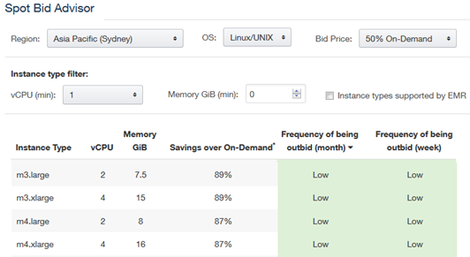
Spot instances
‘Bid’ on unused capacity
Spot Bid Advisor
Pricing History
Spot Fleet
Spot Blocks

Slide 21
Module 4: Managing AWS Expenses
Cost allocation

Slide 22
Activity 4-2
AFL’s monthly cloud bill is US$20,000 with 5 different business units leveraging the cloud.
In a group, discuss and define strategies via which you would allocate that cost back to the business
Will you mark up for the cloud team’s staff? What else might you do a mark up for?
How will you segregate billing between the different business units?

Slide 23
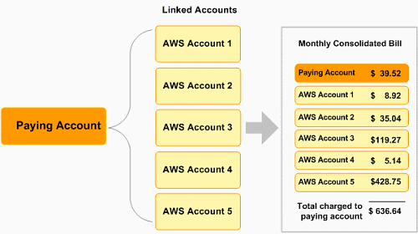
Consolidated billing
An accounting and billing feature
Designate 1 account as the payer, and other accounts as its linked accounts
You get a single bill for multiple AWS accounts
You get to combine usage across accounts to meet volume discount tiers
Example:

Slide 24
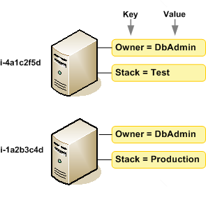
Tagging
Assign metadata to your AWS resources in the form of tags
Help categorize your AWS resources inline with organization data/structure
Types of business tags for cost management and allocation: owner, cost center, BU, project
AWS Cost Explorer and Detailed Billing Records support the ability to breakdown AWS costs by tags
E.g. 2 tags assigned to each instance
Tag 1: “Owner”
Tag 2: “Stack”

Slide 25
Module 4: Managing AWS Expenses
Tools

Slide 26
Tools
AWS Billing and Cost Management
View & Monitor your AWS cost and usage
Analyze with graphs
Create budgets & alerts on costs
Programmatic billing access (Detailed billing files)
Partner Tools
AWS Account Set-up Strategy Guide
AWS Tagging Strategy Guide

Slide 27
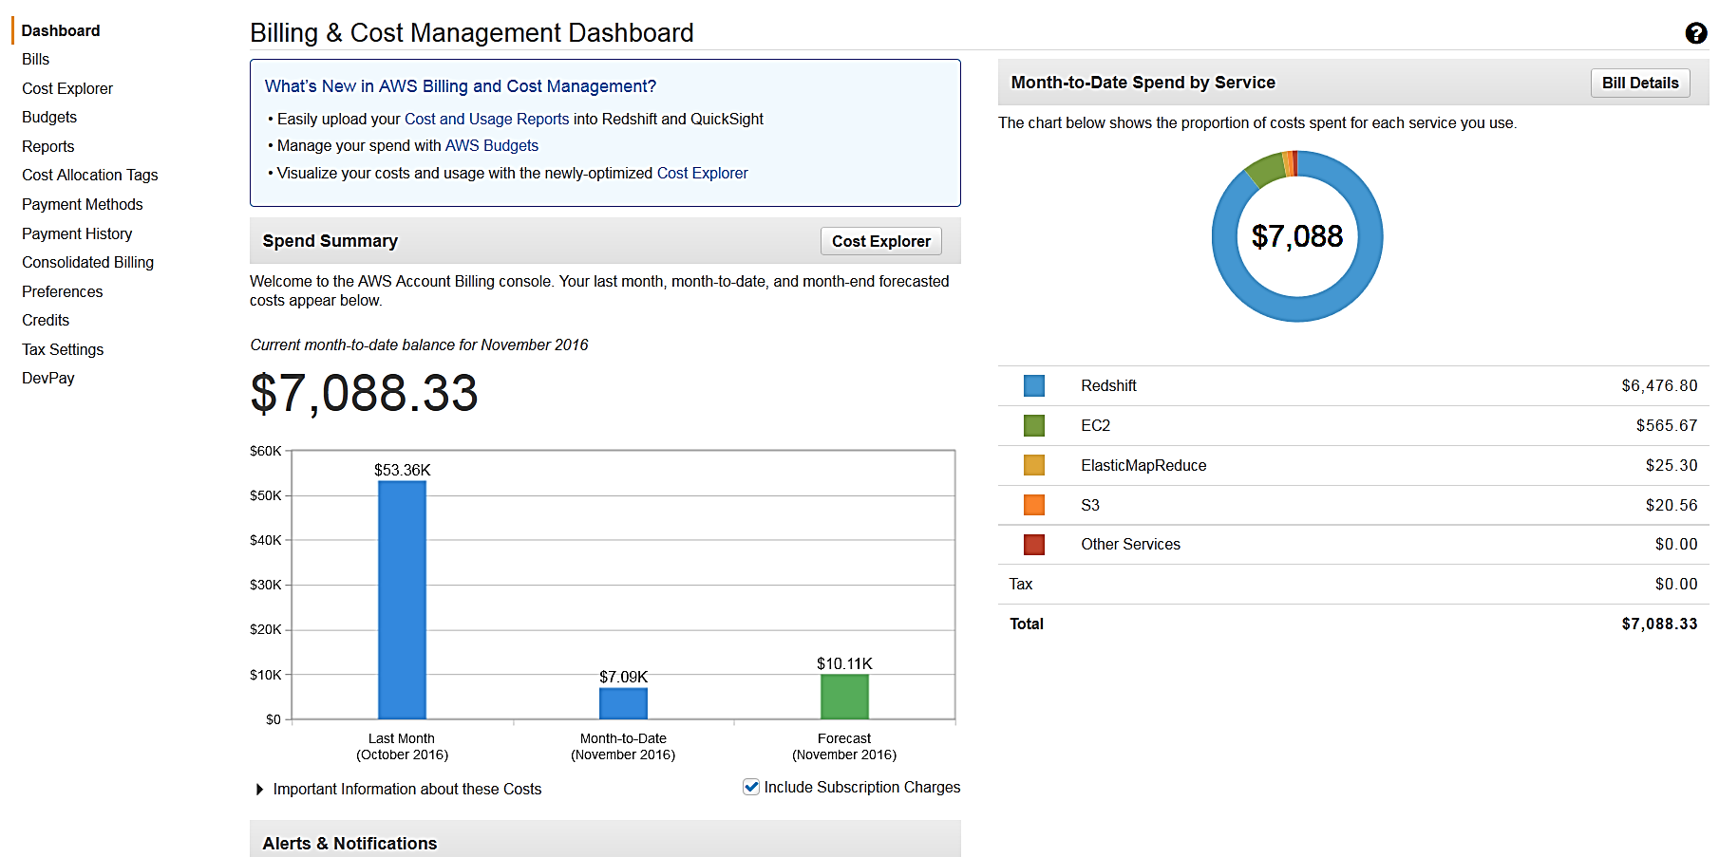
AWS billing & cost management dashboard

Slide 28
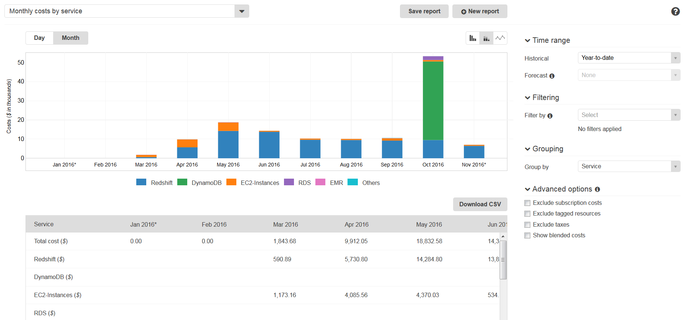
AWS cost explorer

Slide 29
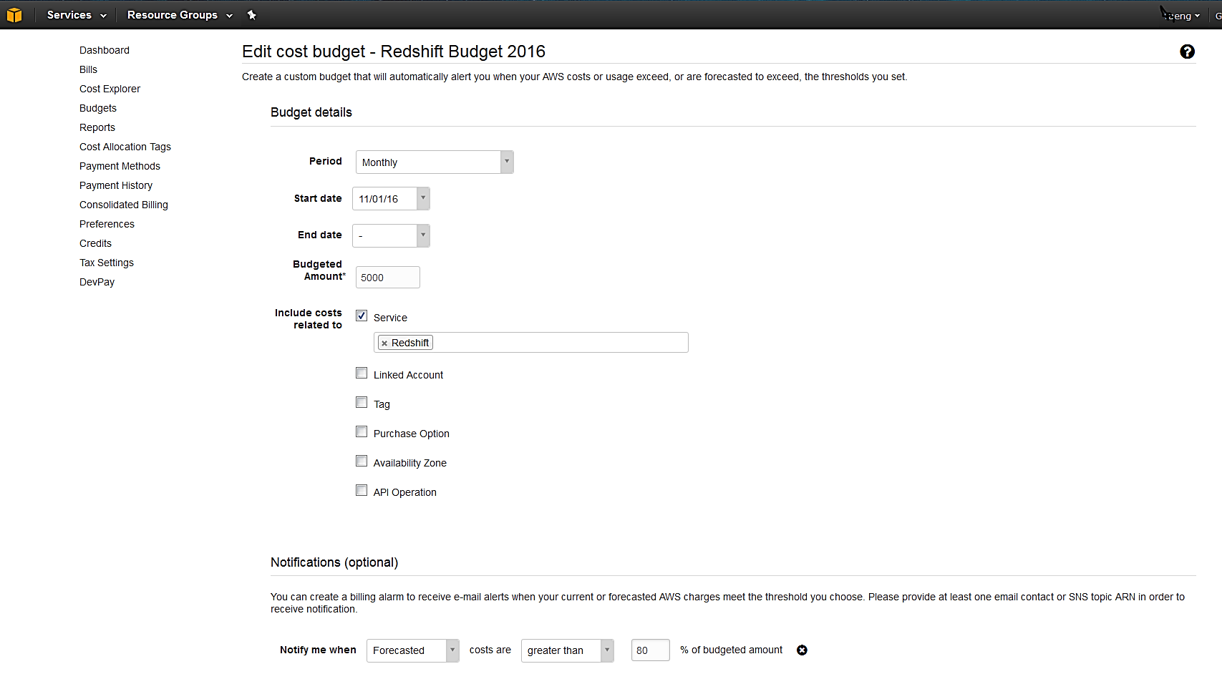
AWS budgets and alarms

Slide 30
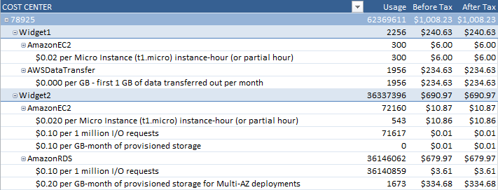
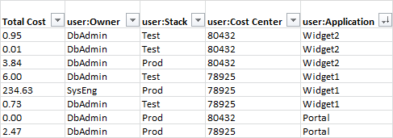
AWS detailed billing reports & cost allocation

Slide 31
Lessons Learnt From Customers
Take advantage of AWS’ purchasing options - buy in the most cost-effective way (On Demand + Spot + Reserved Instances) as fits your requirement
Watch what you are using… match resources to workloads, identify idle and low-usage resources – stop or consolidate them
Tag early as retroactive tagging is not possible
Set up governance and frameworks to manage cloud usage and expenditure – this is similar to project and financial management, really! Your cloud team should do these

Slide 32
Module 4: Managing AWS Expenses

Slide 33
Summary

Slide 34
What did we learn?
Module 1 – Building a Cloud Strategy
Module 2 – Application Migrations
Module 3 – Hiring your Cloud Team
Module 4 – Managing AWS Expenses

Slide 35
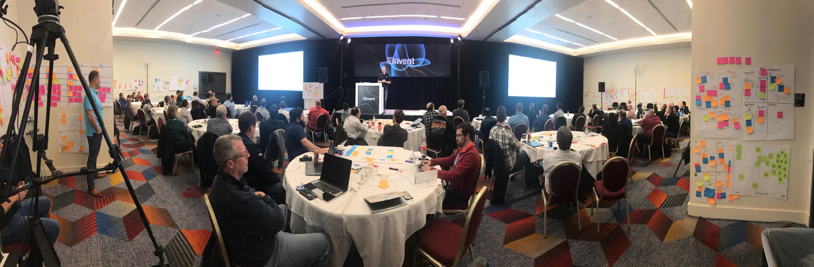
Hard work

Slide 36
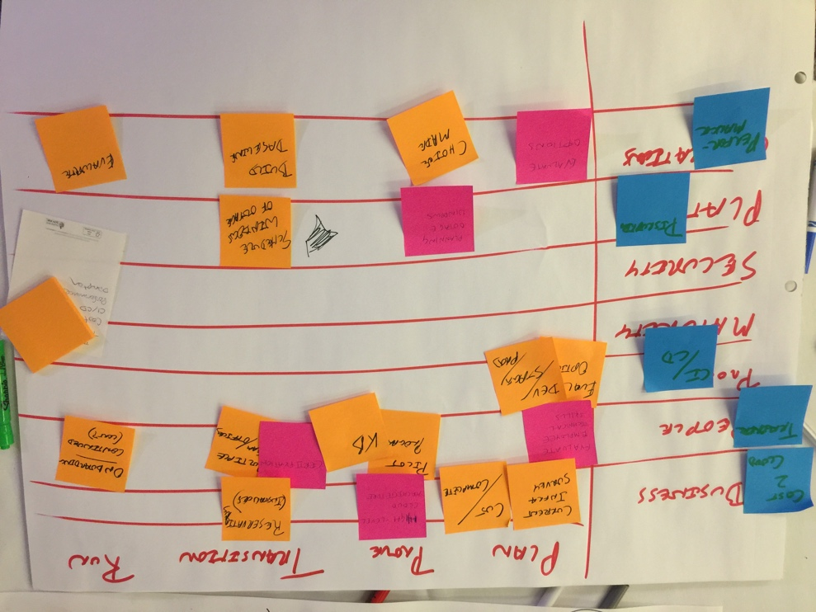
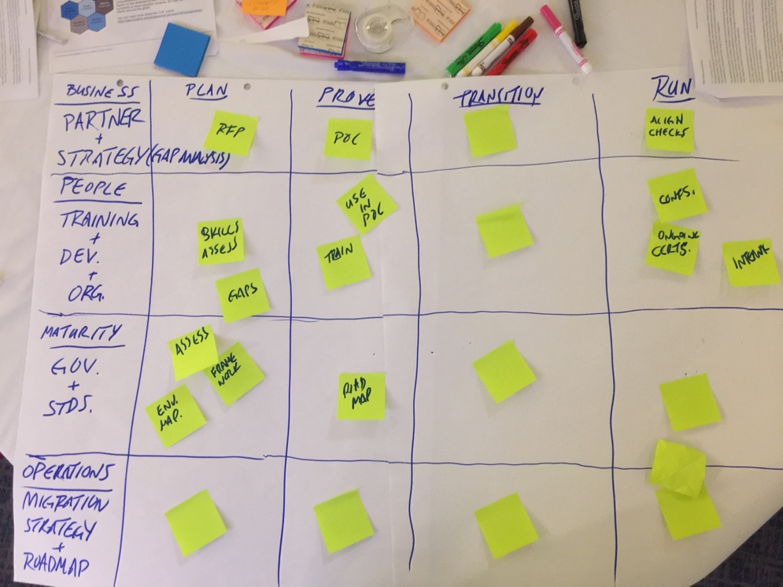
Module 1 – Building a Cloud Strategy

Slide 37
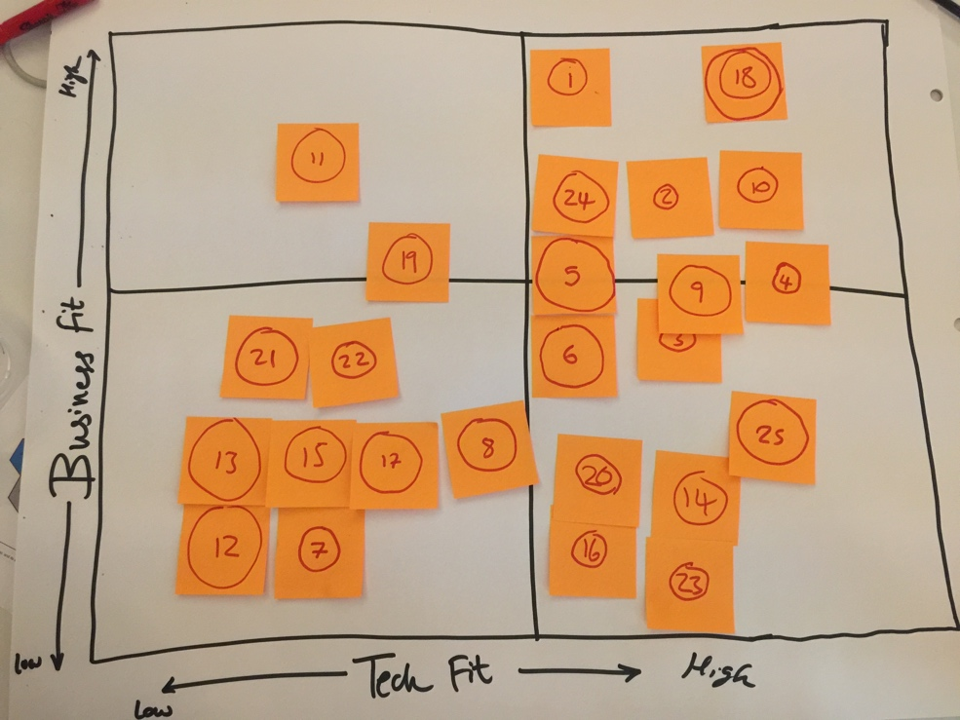
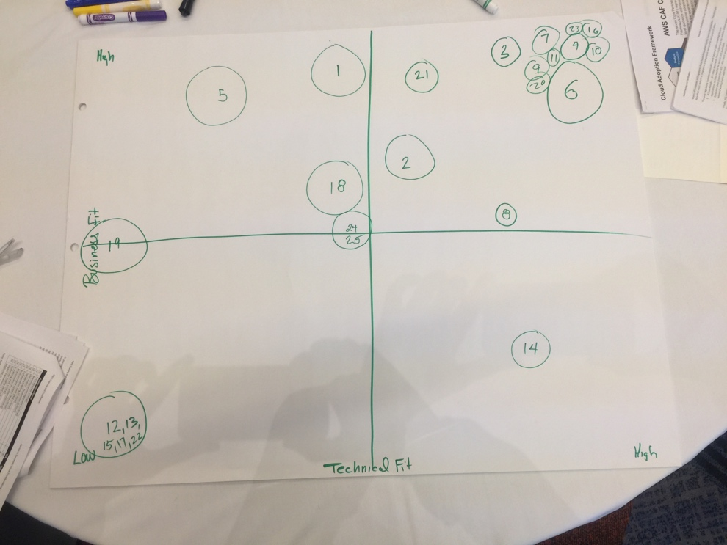
Module 2 – Application Migrations

Slide 38
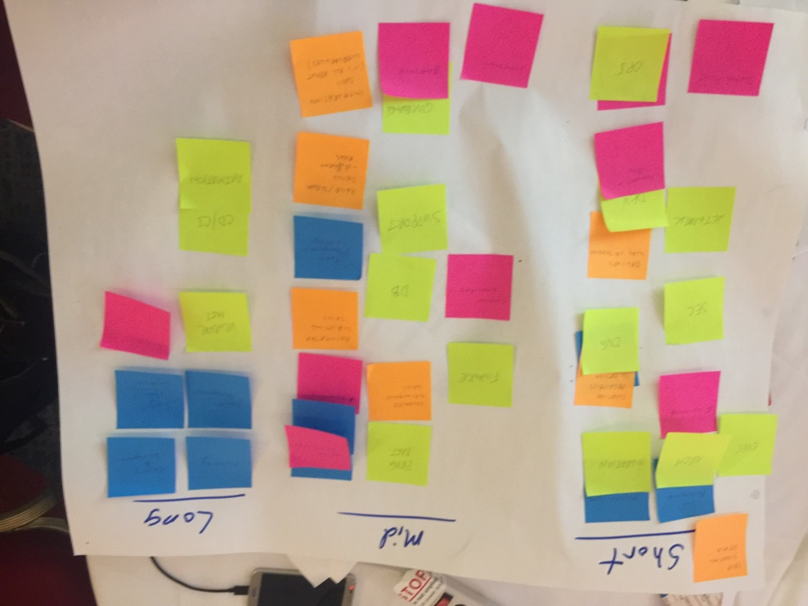
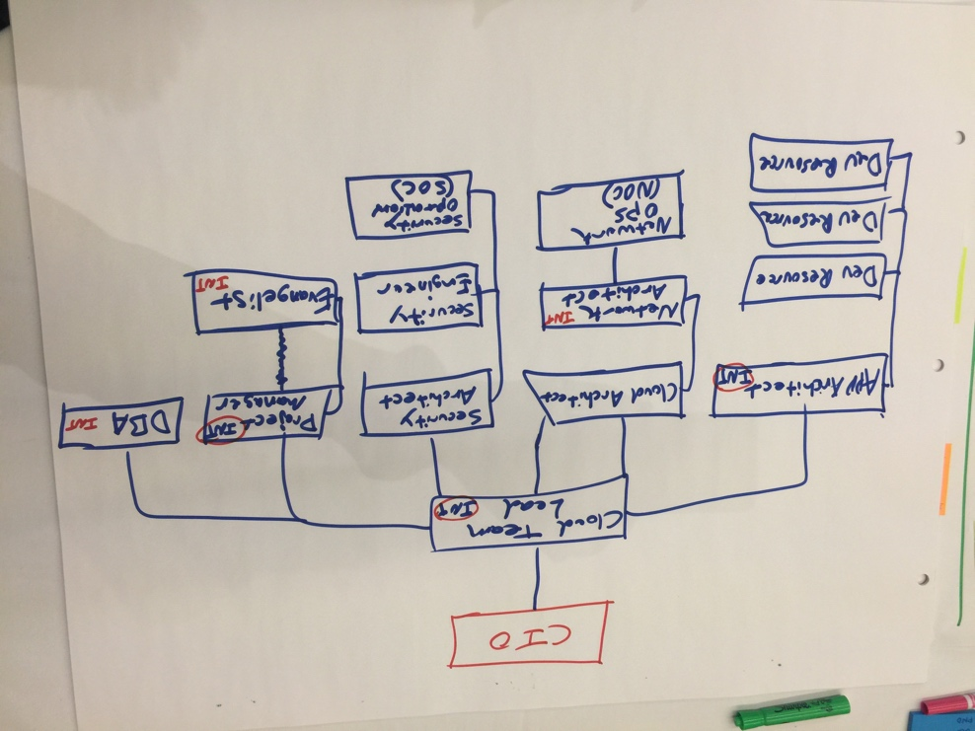
Module 3 – Hiring your Cloud Team

Slide 39
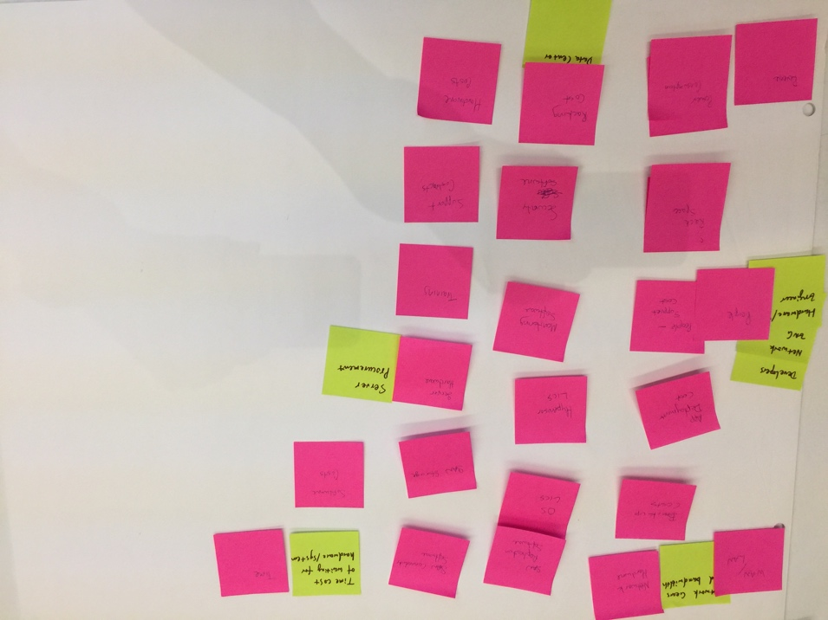
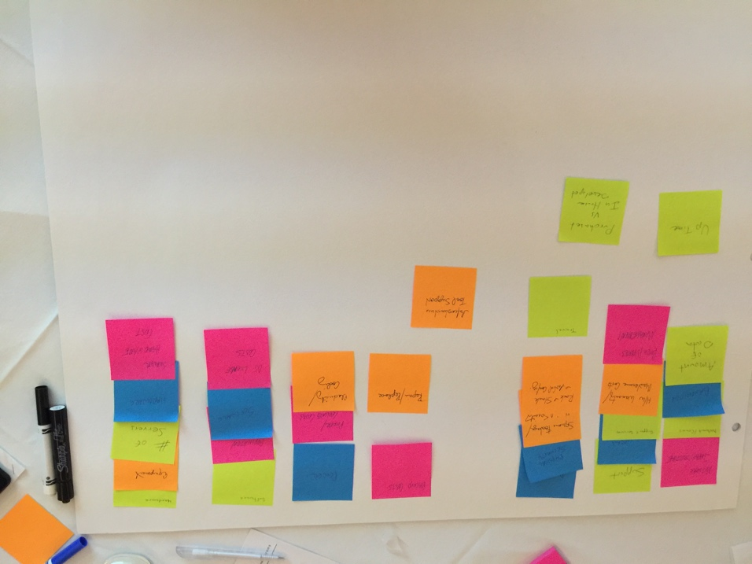
Module 4 – Managing AWS Expenses

Slide 40
How can you use it?
Run these activities in your organization
Develop a plan that works for you
Use the tips and tricks shared to maintain momentum
Reach out to AWS if you need assistance
All course material will be made available on 30-Nov

Slide 41
Please rate and provide feedback
Re:Invent mobile app.
Go to “My Evaluations”
Rate this session
Provide feedback on how we can improve.

